Slide 1



The Watershed Experience
Notes:
Materials:
-Graphing paper
-Flip chart+flip chart markers
-Colored pencils, pencils
-Ruler

Slide 2


Visualizing Data:
Charts, Graphs, Infographics

Slide 3
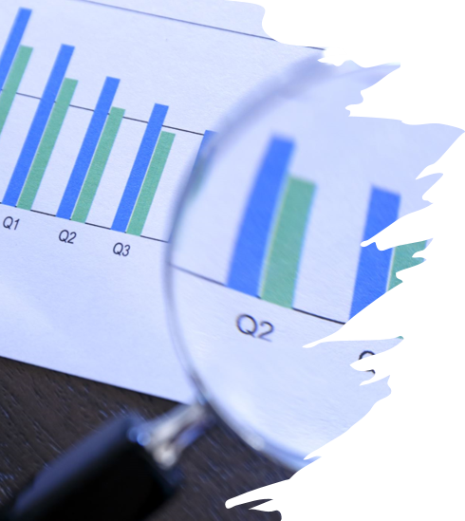
What is Data?
A collection of values or indicators that
convey information, such as...
  Quantity
  Quality
  Facts
  Statistics

Slide 4
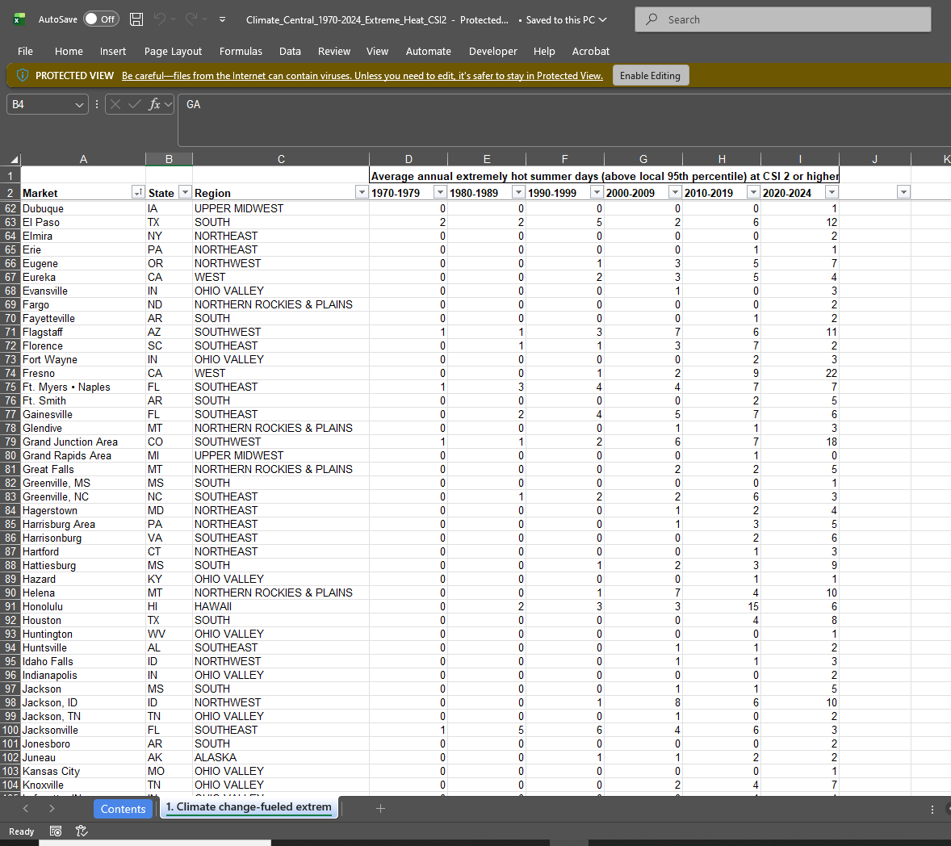
What Does
Data Look Like?

Slide 5
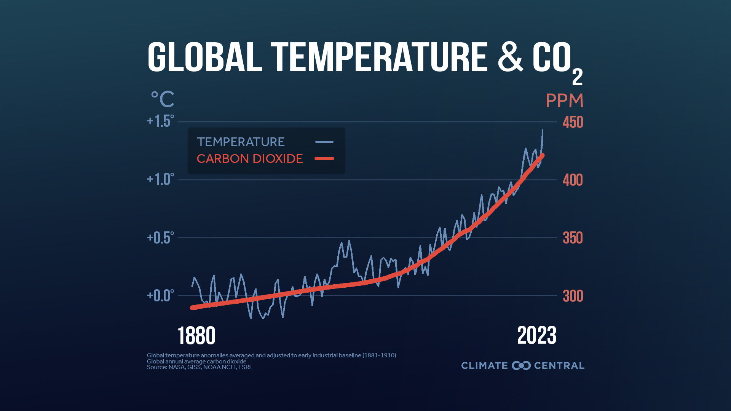
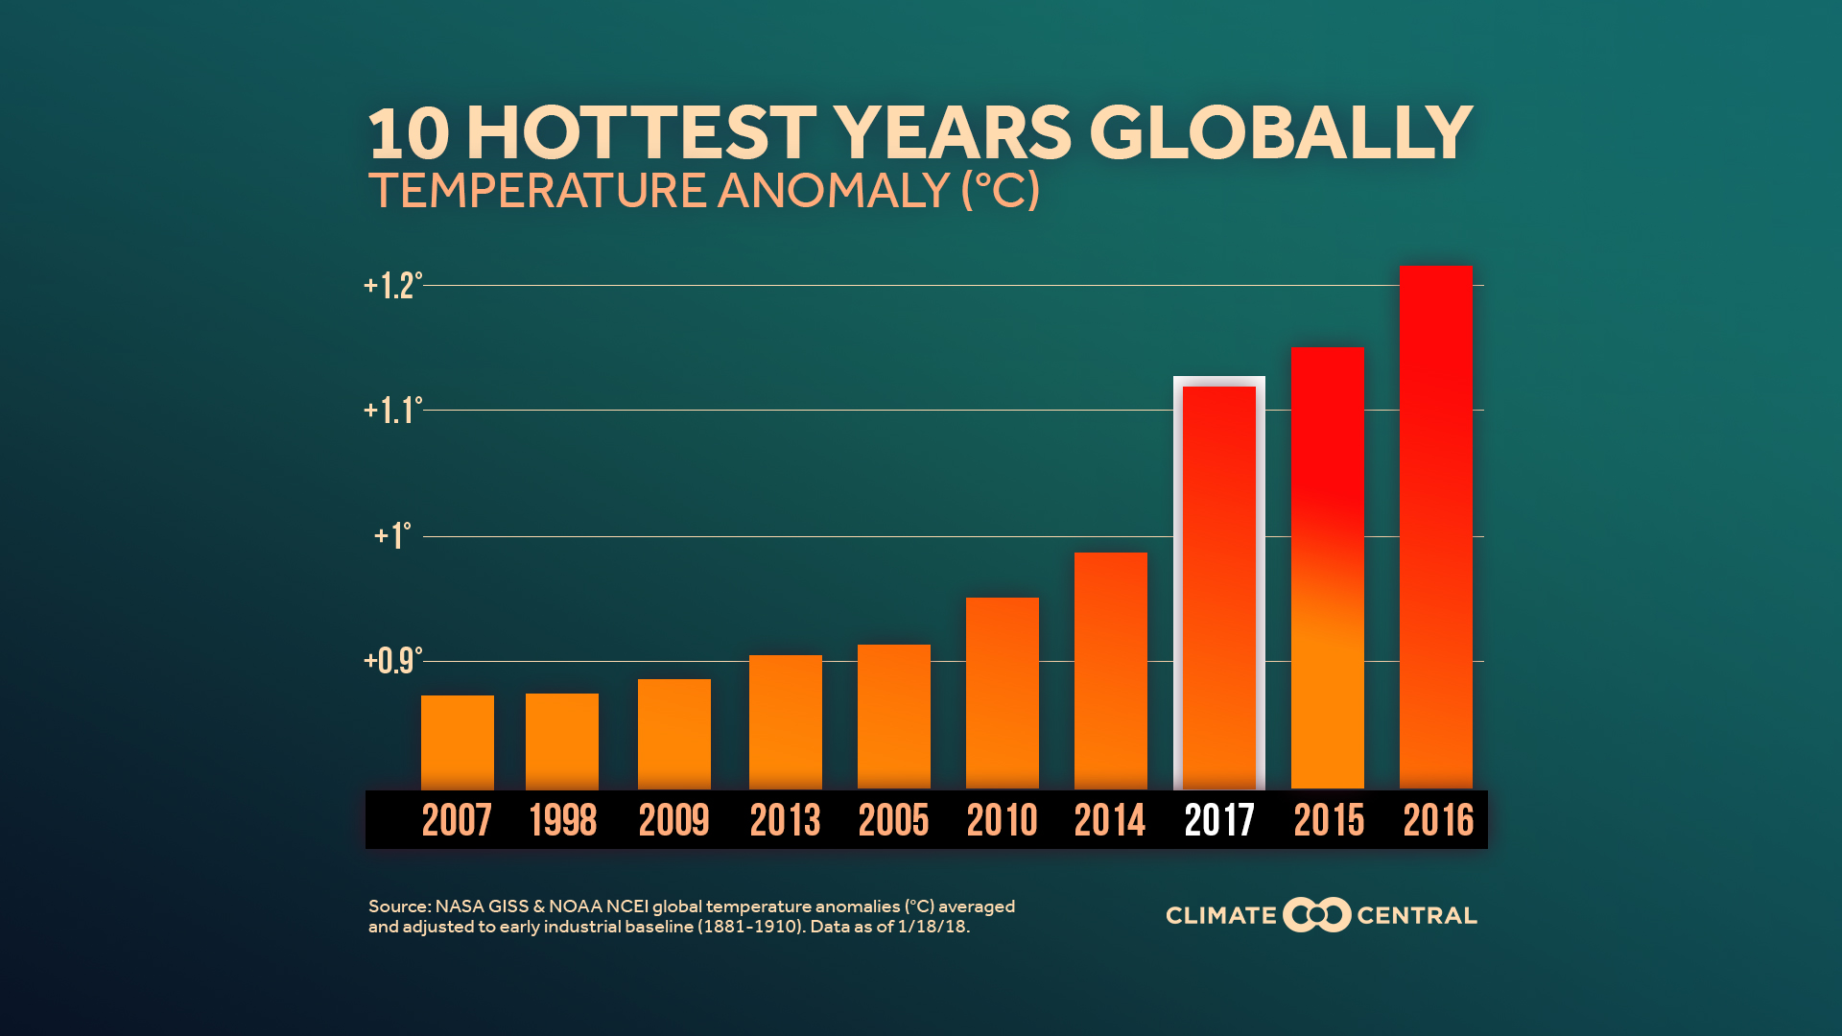
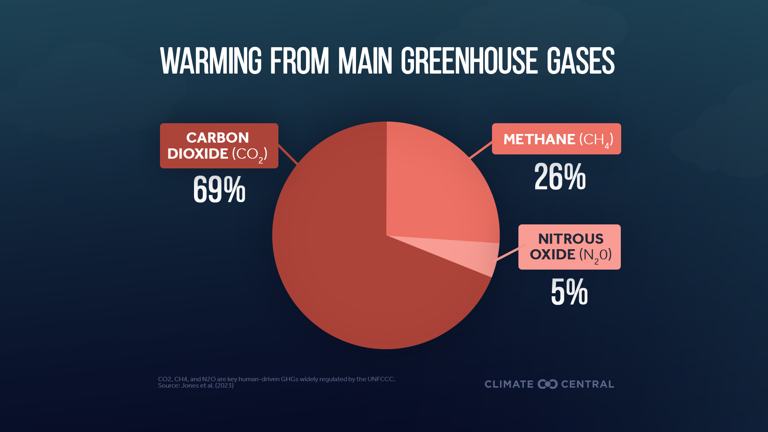
Sample Graphs
Line Graph
Bar Graph
Pie Chart

Slide 6
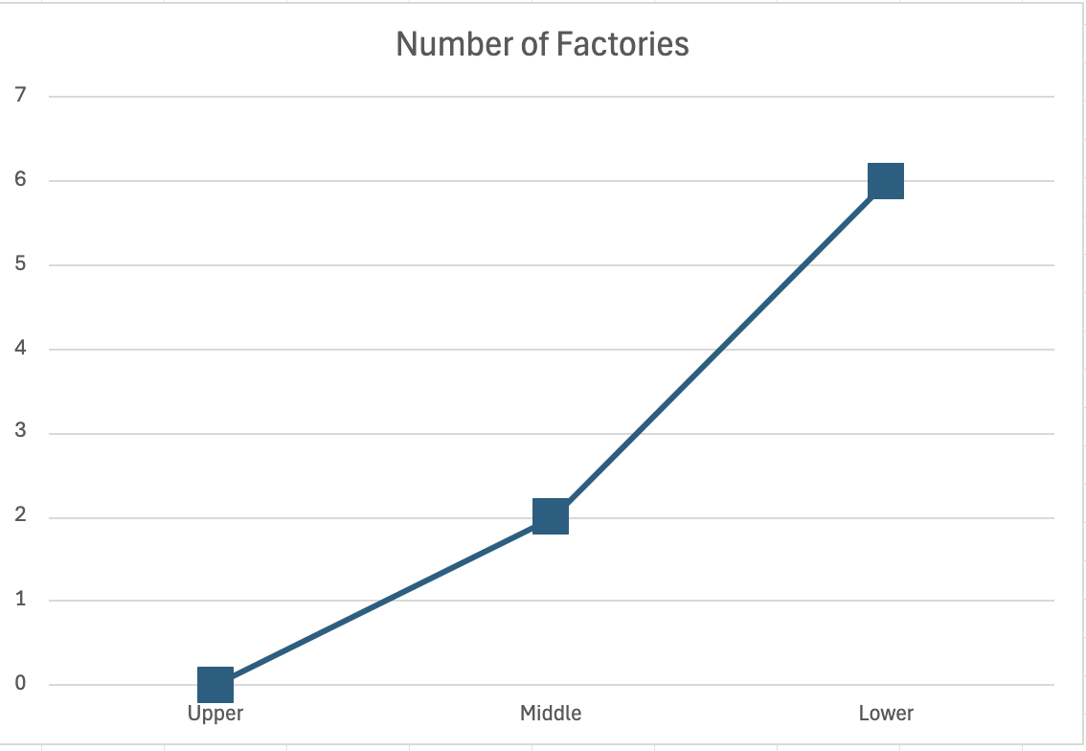
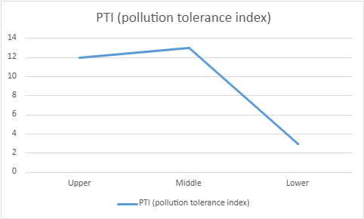
Line Graph
Notes:
Line graph of 2024 data. Number of factories and PTI.

Slide 7
Bar Graph
Notes:
Pollution tolerance index from line graph now shown through a bar graph.
Which graph makes it easier to understand the data?

Slide 8
Bar Graph: Clustered Columns

Slide 9
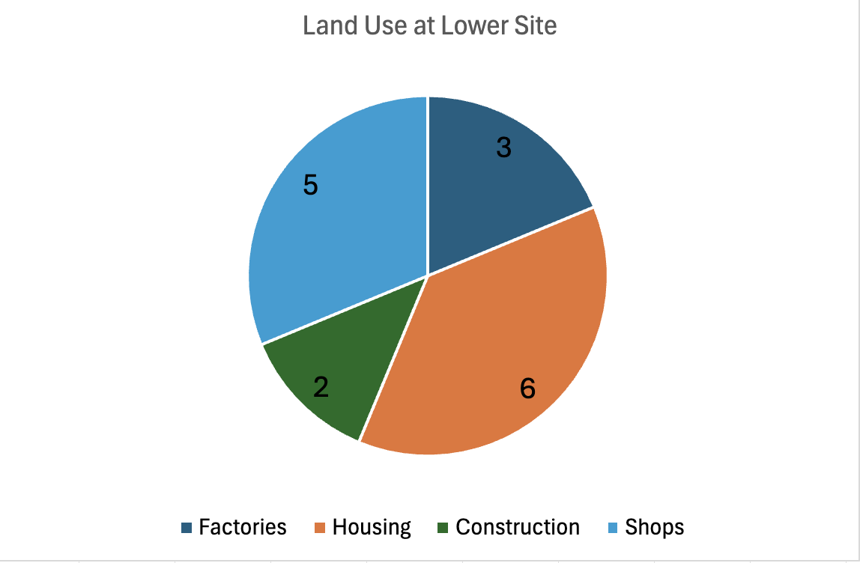
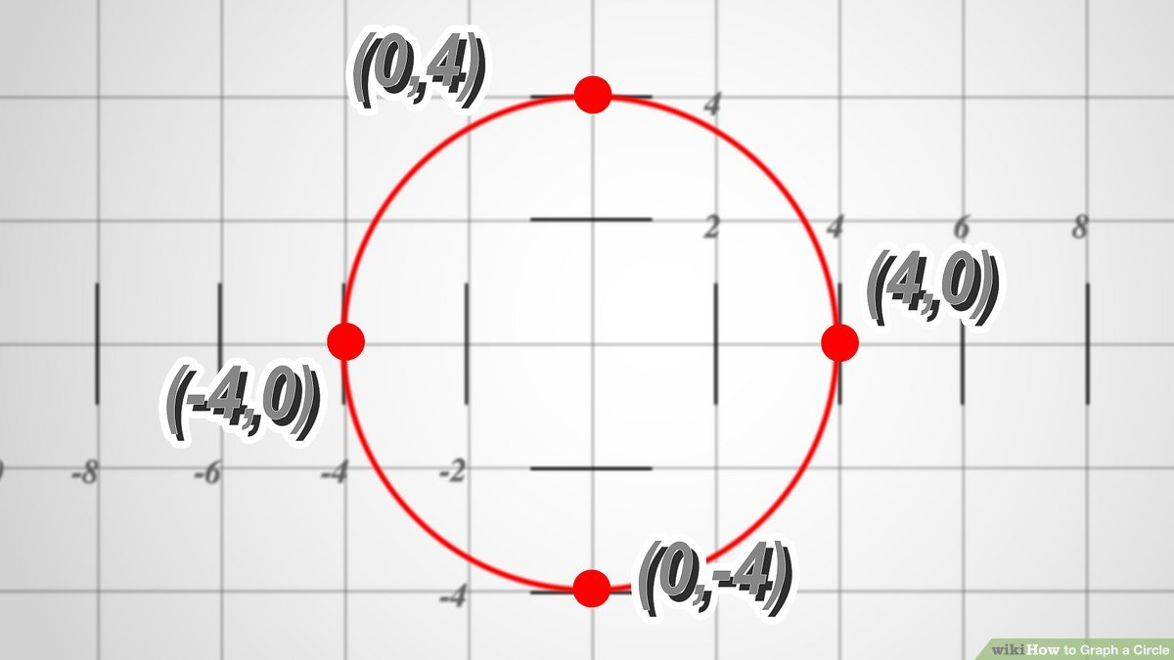
The Pie Chart
How to make a circle on graph paper

Slide 10
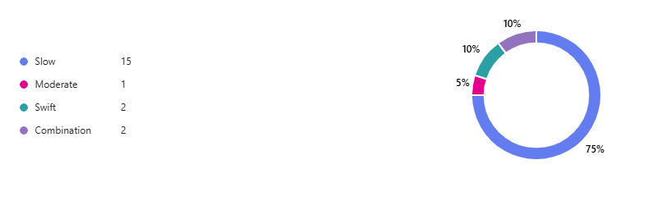
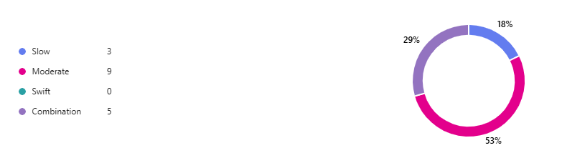
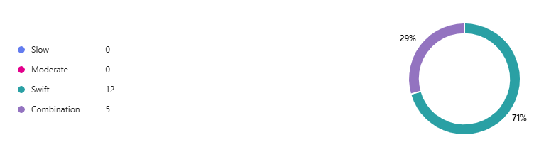
Upper
Visual
(Stream Flow):
Ring Charts
Middle
Lower

Slide 11
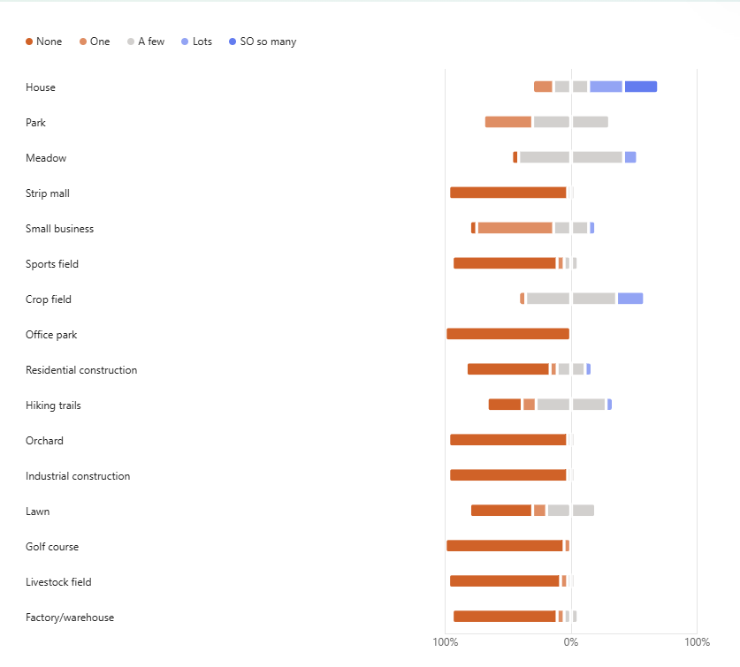
Upper Assunpink
Land Use:
Stacked Bar Chart

Slide 12

Let's Try: Data Collection
We're gathering some data about what makes you, you!
Plot your data on the flip chart.
Height
Shoe size
Let's discuss!
Notes:
-What does this data tell us? Is this data easy or hard to read/interpret?
-What is our conclusion? How do we know?
-Why don't we know?
-How can we make sense of this data?

Slide 13
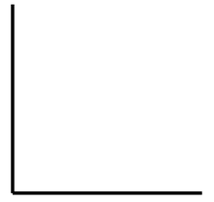
Let's Try: Data Plotting
X-axis is shoe size.
Y-axis is height (inches).
Find the spot where your shoe size and height intersect.
Mark with one dot, big enough to see.
y-axis
x-axis
Notes:
Practice reading graph, go over where to mark data points

Slide 14
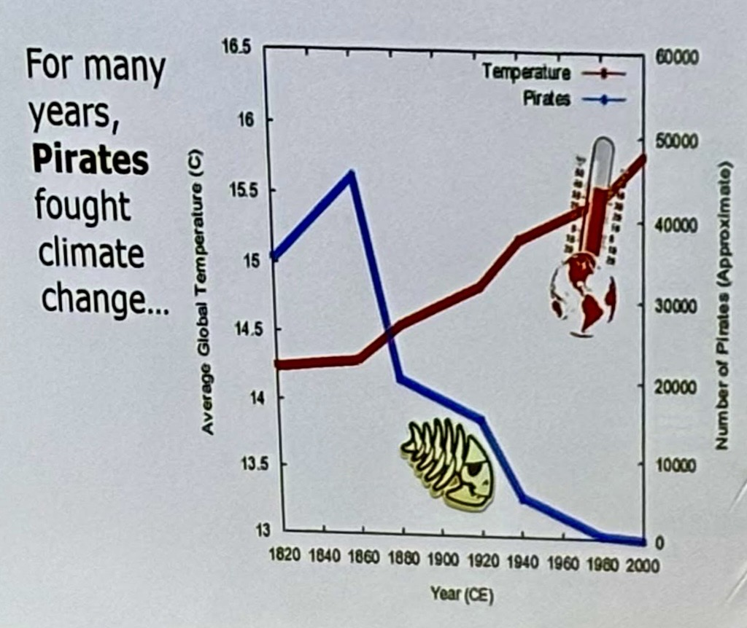
Let's Try: Data Conclusions
Notes:
-What limitations can data have?
-What problems might we run into when we try to draw conclusions?
-Why does it matter?

Slide 15
Visualizing Our Water Quality Data:
Biological, Chemical, Visual, and Land Use

Slide 16

Graphing Our Data
Using the data tables and prompts provided, make a chart or graph on graph paper
Discuss which is more effective for understanding that data
Graph Title
y-axis
x-axis

Slide 17
Let's Try It Again: Data Collection with Google Sheets
We're gathering some data about what makes you, you!
Record your response in the shared Google Sheet.
Height
Shoe size
Let's discuss!
Notes:
-What does this data tell us? Is this data easy or hard to read/interpret?
-What is our conclusion? How do we know?
-Why don't we know?
-How can we make sense of this data?
Add animation

Slide 18
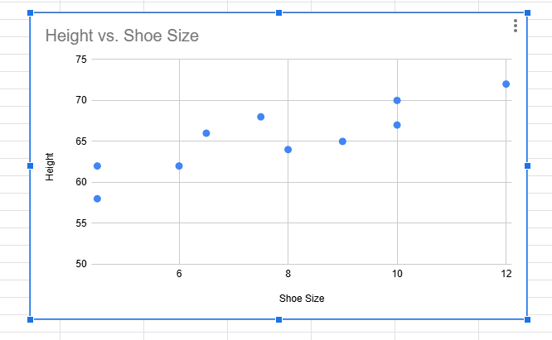
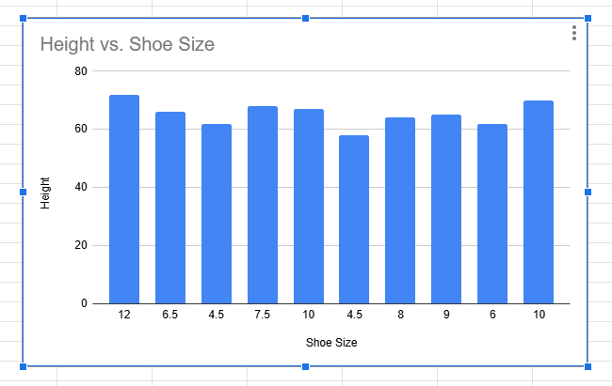
Let's Try It Again: Graphs and Charts
Make a scatter graph and a bar graph in Google Sheets.
Notes:
Add animation
Let's try again.
-What does this data tell us? Is this data easy or hard to read/interpret?
-What is our conclusion? How do we know?
BUT WAIT!
-What don't we know? What are the limitations of this data set? Are we missing data we need to draw a valuable conclusion?

Slide 19
Making Our Own Charts and Graphs
Make a copy of the sheet.
Use the graphing prompt you had previously.
Make several graphs and charts to determine which ones show meaning with your data.
  You may need to reformat, edit, or combine data to make the most effective chart.

Slide 20

Relevant Careers:
Data Scientist
Data Analyst
Data Visualization Engineer
Analytics Manager
Business Intelligence Analyst
Notes:
Data Scientist: Data scientists search for patterns in data and help organizations make decisions based on their findings. They create algorithms and data models to forecast outcomes, sometimes adopting machine learning techniques to improve products or tools.
Data Analyst: Analytics managers are team leaders in charge of translating data into actionable insights for an organization.
Data Visualization Engineer: Data visualization engineers are data and storytelling experts who make data sets more visually understandable in a variety of ways such as engineering dashboards.
Analytics Manager: Analytics mangers work with a team to translate data into insights that are useful to the organization.
Business Intelligence Analyst: BI Analysts interpret data specific to businesses, such as sales revenue, market trends, and customer engagement metrics. They look for improvements that can be made to generate more profit for the business and become more relevant to their market.
5 Data Visualization Jobs to Know in 2025 (+ Top Skills) | Coursera

Slide 21
Conclusions
Notes:
https://monitormywatershed.org/browse/

