Slide 1
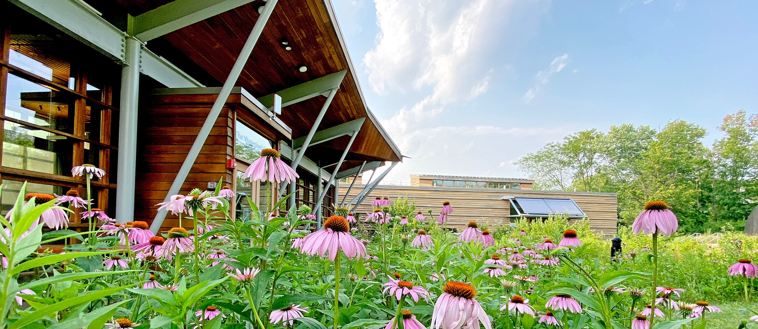


The Watershed Experience

Slide 2
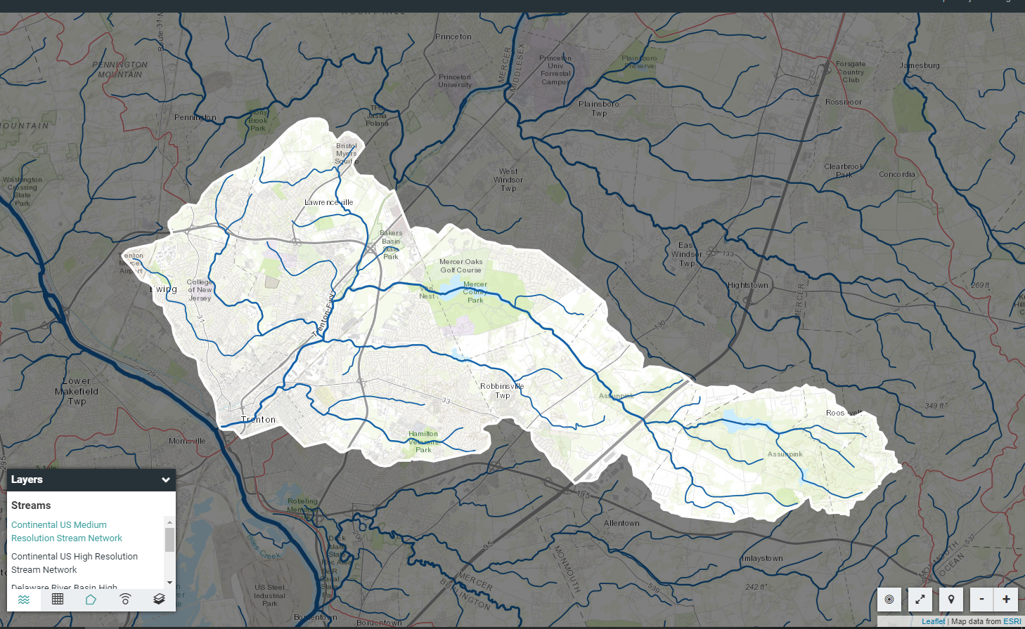
The Assunpink Watershed
Insert your own map with your sites marked on it
Middle Site
Lower Site
Upper Site

Slide 3
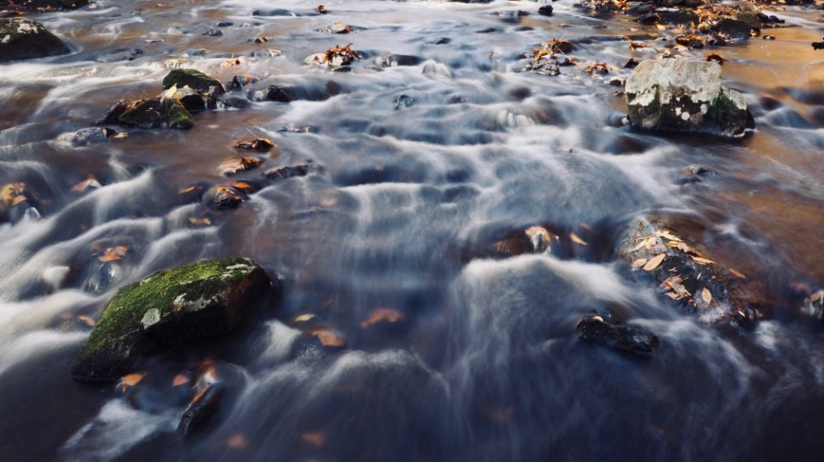

Data we collected
Visual, Biological, Chemical, Land Use

Slide 4

The Question Formulation Technique (QFT)
The Right Question Institute offers many of our materials through a Creative Commons License and we encourage you to make use of and/or share this resource. Please reference the Right Question Institute as the source on any materials you use. ​
​
Source: www.rightquestion.org

Slide 5
Rules for Producing Questions
1. Ask as many questions as you can
2. Do not stop to answer, judge, or discuss
3. Write down every question exactly as stated
4. Change any statements into questions
Source: www.rightquestion.org

Slide 6
Question Focus
We collected data from three sites in the watershed.
→Please write this statement at the top of your paper.
→Remember: Number the questions. Follow the rules.
Source: www.rightquestion.org

Slide 7
Rules for Producing Questions
1. Ask as many questions as you can
2. Do not stop to answer, judge, or discuss
3. Write down every question exactly as stated
4. Change any statements into questions
Source: www.rightquestion.org

Slide 8
Categorizing Questions: Closed/ Open
Definitions:
  Closed-ended questions can be answered with a “yes” or “no” or with a one-word answer.
  Open-ended questions require
  more explanation.
Directions: Identify your questions as closed-ended or open-ended by marking them with a “C” or an “O.”
Source: www.rightquestion.org

Slide 9
Discussion
Closed-ended Questions
Advantages
Disadvantages
Disadvantages
Source: www.rightquestion.org
Notes:
Luz: Give your directions.
Sarah: TYPE a RESPONSE in the chat box now.
SARAH read some questions.
Luz: Disadvantages.

Slide 10

Discussion
Open-ended Questions
Advantages
Disadvantages
Source: www.rightquestion.org
Notes:
Luz: Give the directions.
Sarah: TYPE a RESPONSE in the chat box now.
Sarah: Read some questions.
Luz: Disadvantages
Luz : The point here is that the closed ended questions are equally useful as open-ended!!! DRIVE HOME the POINT!!

Slide 11
Improving Questions
Take one closed-ended question and change it into an open-ended question.
Take one open-ended question and change it into a closed-ended question.
Closed
Open
Open
Closed
Source: www.rightquestion.org
Notes:
Luz: Read Slide. 1 ½ Minutes. Pause & Time. DO NOT ASK THEM TO SHARE.
* Winston: Add the gif to this slide to go along with the final animation

Slide 12
Strategize: Prioritizing Questions
Review your list of questions
  Choose the three questions you consider most important.
  While prioritizing, think about your Question Focus: We collected data from three sites in the watershed.
After prioritizing consider…
  Why did you choose those three questions?
  Where are your priority questions in the sequence of your entire list of questions?
Source: www.rightquestion.org

Slide 13
Strategize: Action Plan
From priority questions to action plan…
In order to answer your priority questions:
    What do you need to know? Information
    Source: www.rightquestion.org
    What do you need to do? Tasks
Source: www.rightquestion.org

Slide 14
Strategize: Action Plan
In order to answer your priority questions:
  What do you need to know? Information
  What do you need to do? Tasks
Information | Tasks
Source: www.rightquestion.org

Slide 15
Share
Questions you changed from open/closed
Your three priority questions and their numbers in your original sequence
Rationale for choosing priority questions
Next steps from your action plan
Source: www.rightquestion.org

Slide 16
Reflection
What did you learn?
How did you learn it?
Source: www.rightquestion.org

Slide 17
Chem - Dec 2024 |  |  |  |  |  |  |  |  |  | Bio - Fall 2024
Location | Air temp © | Water temp © | pH | DO (ppm) |  | Salinity (ppt) | Turbidity (JTU) | Nitrates (ppm) | Phosphates (ppm) | Pollution Tolerance Index
Upper | 2 | 1 | 7.5 | 4 |  | 0 | 25 | 0 | 0 |  | 12 | Fair
Middle | 2 | 7 | 6 | 12 |  | 0 | 50 | 2 | 0.2 |  | 13 | Fair
Lower | 3 | 5 | 8 | 8 |  | 0 | 5 | 6 | 0.4 |  | 3 | Poor

Slide 18
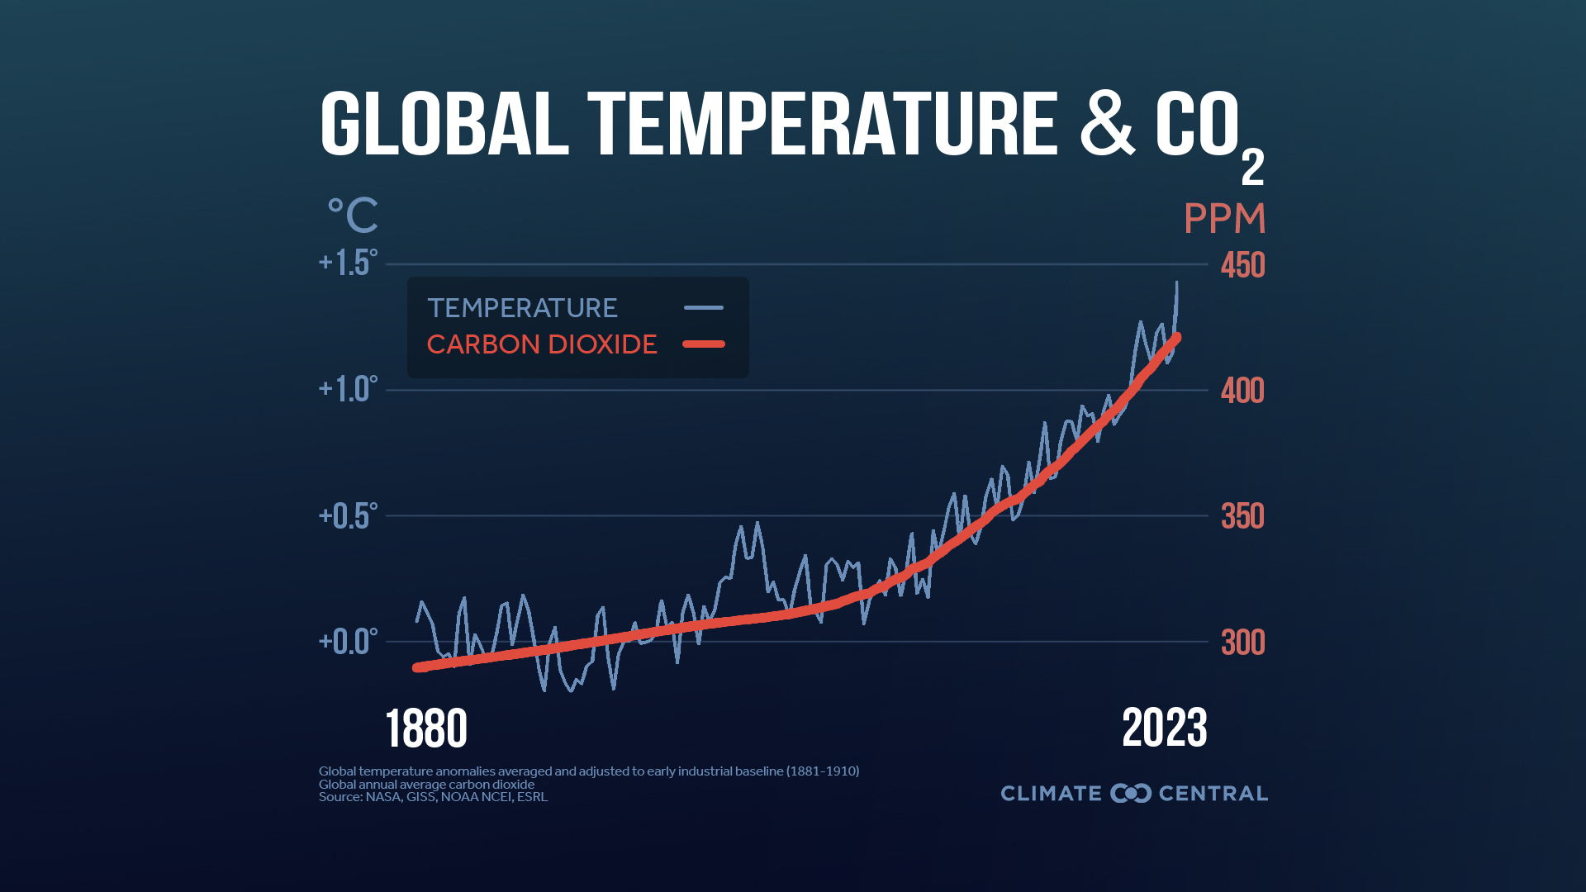
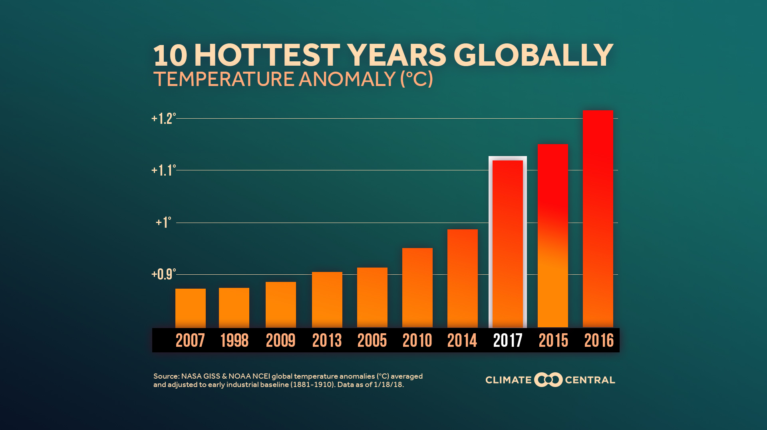
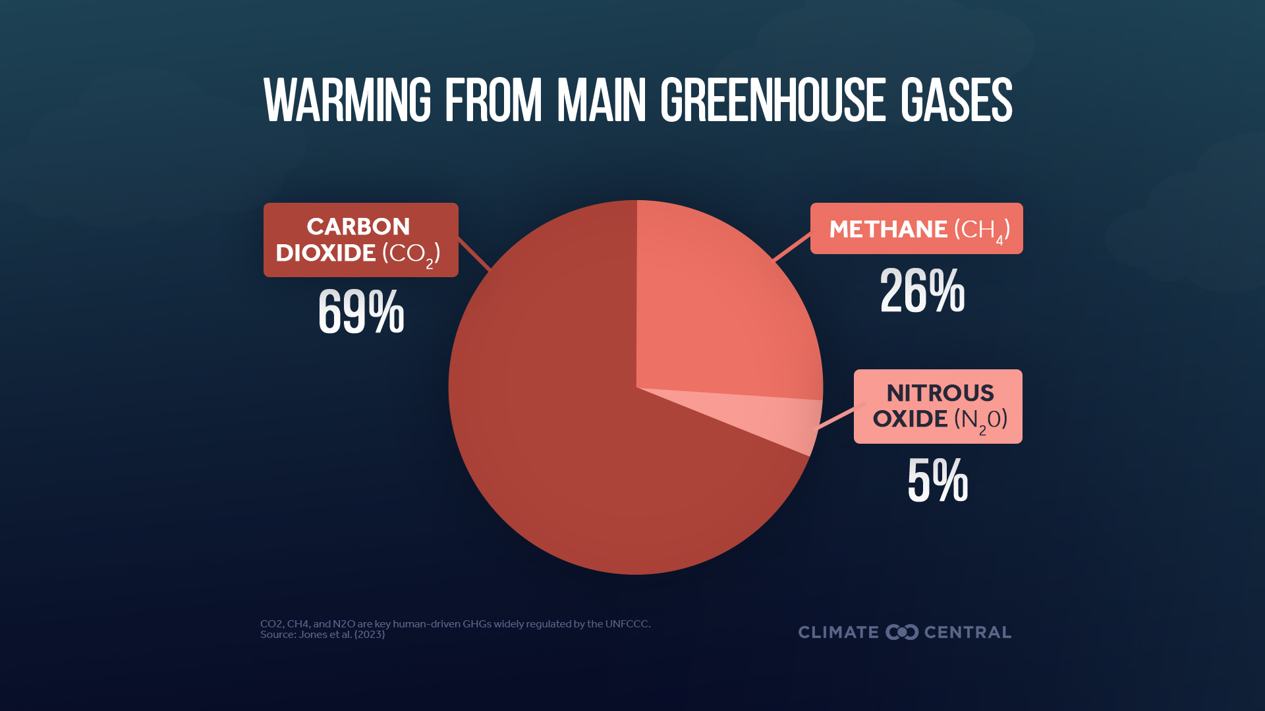
Line Graph
Bar Graph
Pie Chart

Slide 19
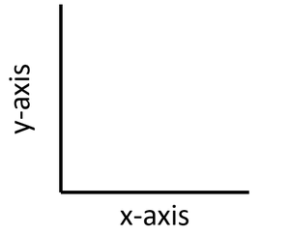
Graphing Layout
NUMERICAL Data
SITE Data

Slide 20
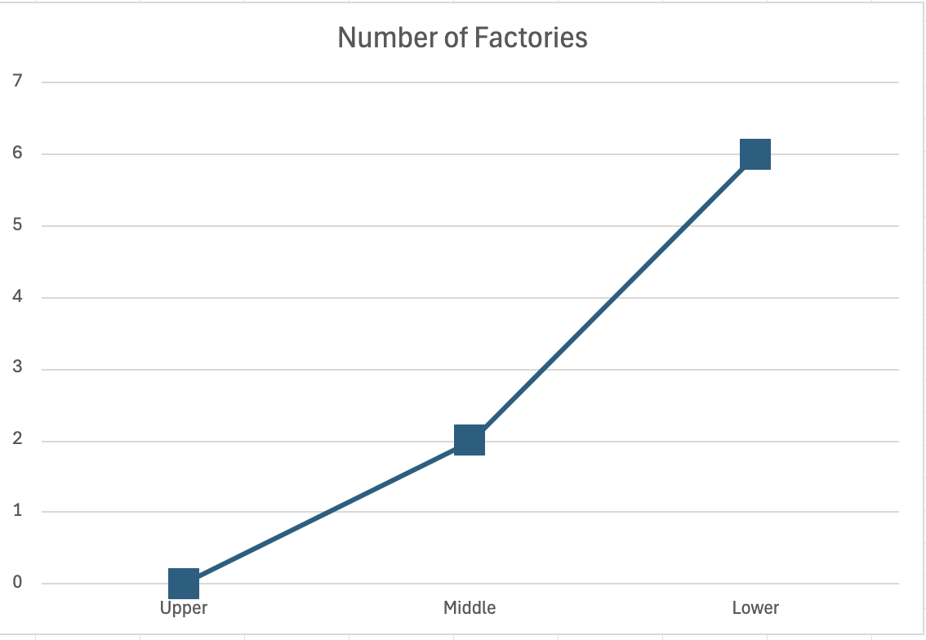
Line Graph

Slide 21
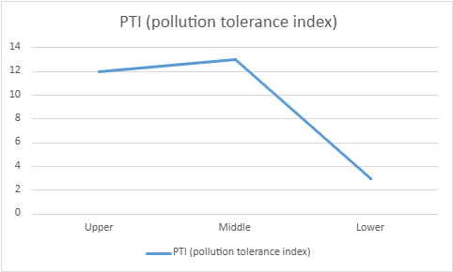
Line Graph

Slide 22
Bar Graph

Slide 23
Bar Graph – Clustered Columns

Slide 24
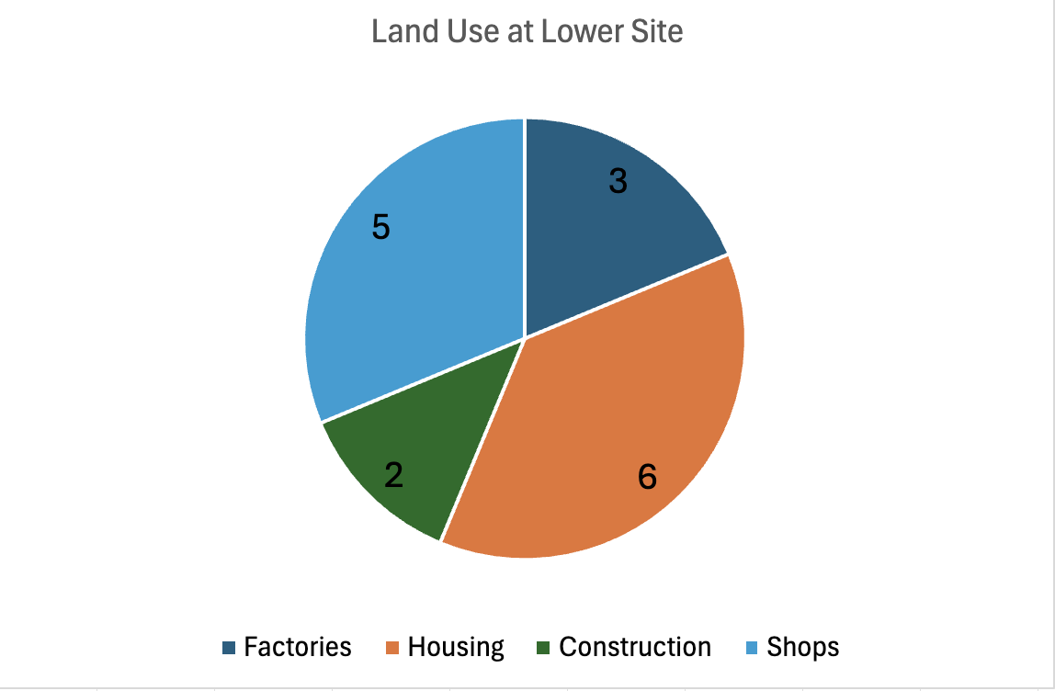
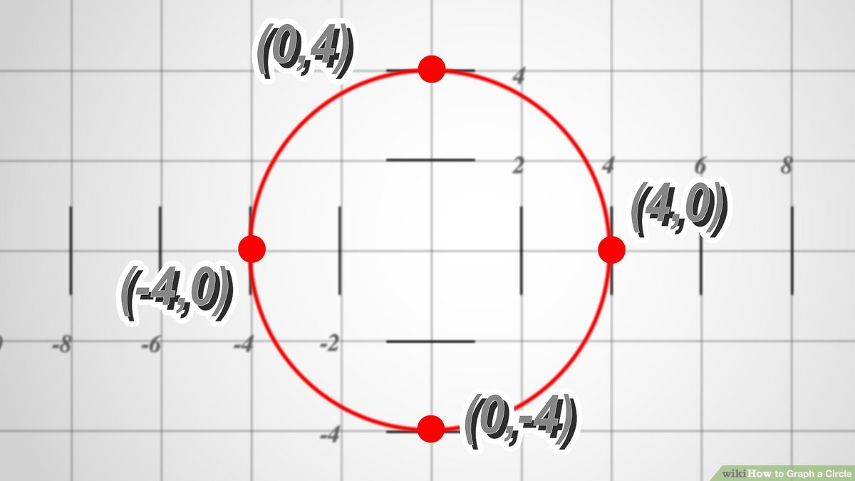
The Pie Chart
How to make a circle on graph paper

Slide 25
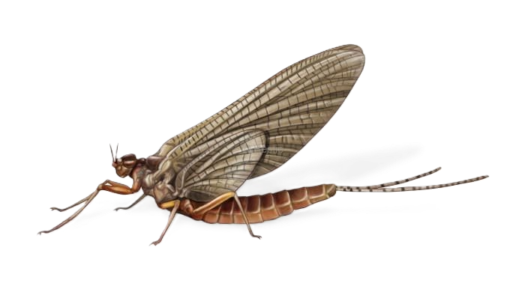
Next Steps
Restate your priority question
Decide which data you need to answer it
Decide which method is the best way to show your data
Make your charts or graphs
Notes:
https://monitormywatershed.org/browse/
Class timing:
9:05-9:10 – Intro to the lesson
9:10-9:20 – How to graph slides
9:20-9:30 – Explain game plan, do an example
9:30-9:55 – Graphing in groups
9:55-10:10 – Sharing and Conclusions
10:10 – Post Survey
10:15 – Academy pitch

